Slide 1

ILP 2023 – W5S1+ Project (End)
Matthieu DE MARI – Singapore University of Technology and Design

Slide 2
Survey and course feedback
You should have received a survey link, asking for your feedback about this summer school.
If not done already, take a minute to fill it up!

Slide 3
Project
Let us continue with activities from the project (previous lecture!)

Slide 4
ILP 2023 – W5S2-3 Everything about strings
Matthieu DE MARI – Singapore University of Technology and Design

Slide 5
Outline (Week5, Session2-3 – W5S2-3)
The string type (and similarities with the list type)
Indexing, slicing, and traversing a string
Updating a string and unmutability
Membership and find
Booleans on strings, sorting
Printing and formatting
Strings <-> lists conversions
Splitting, character checking
(More stuff, RTFM!)

Slide 6
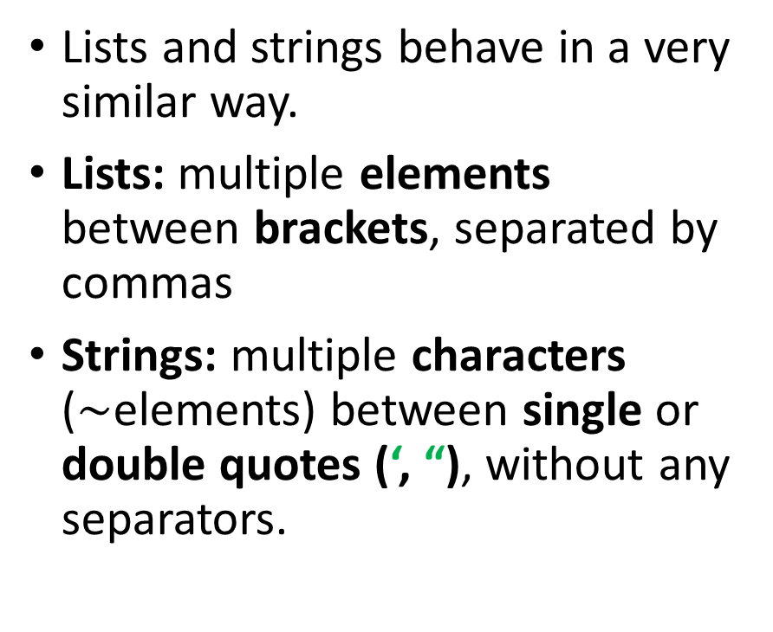
From lists to strings
Lists and strings behave in a very similar way.
Lists: multiple elements between brackets, separated by commas
Strings: multiple characters ($\sim$elements) between single or double quotes (‘, “), without any separators.
Strings are roughly the same thing as a list of characters.
string = “Hello”
equivalent_list = [“H”, “e”, “l”, “l”, “o”]
Great news: This means that most functions, methods and operators working on lists will work on strings as well!

Slide 7
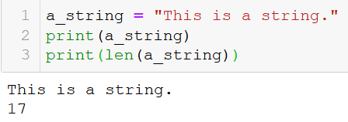
Length of a string
The length of a string is simply defined as the number of characters in the string.
This is obtained, as before via the len() function.
Spaces count as characters!

Slide 8
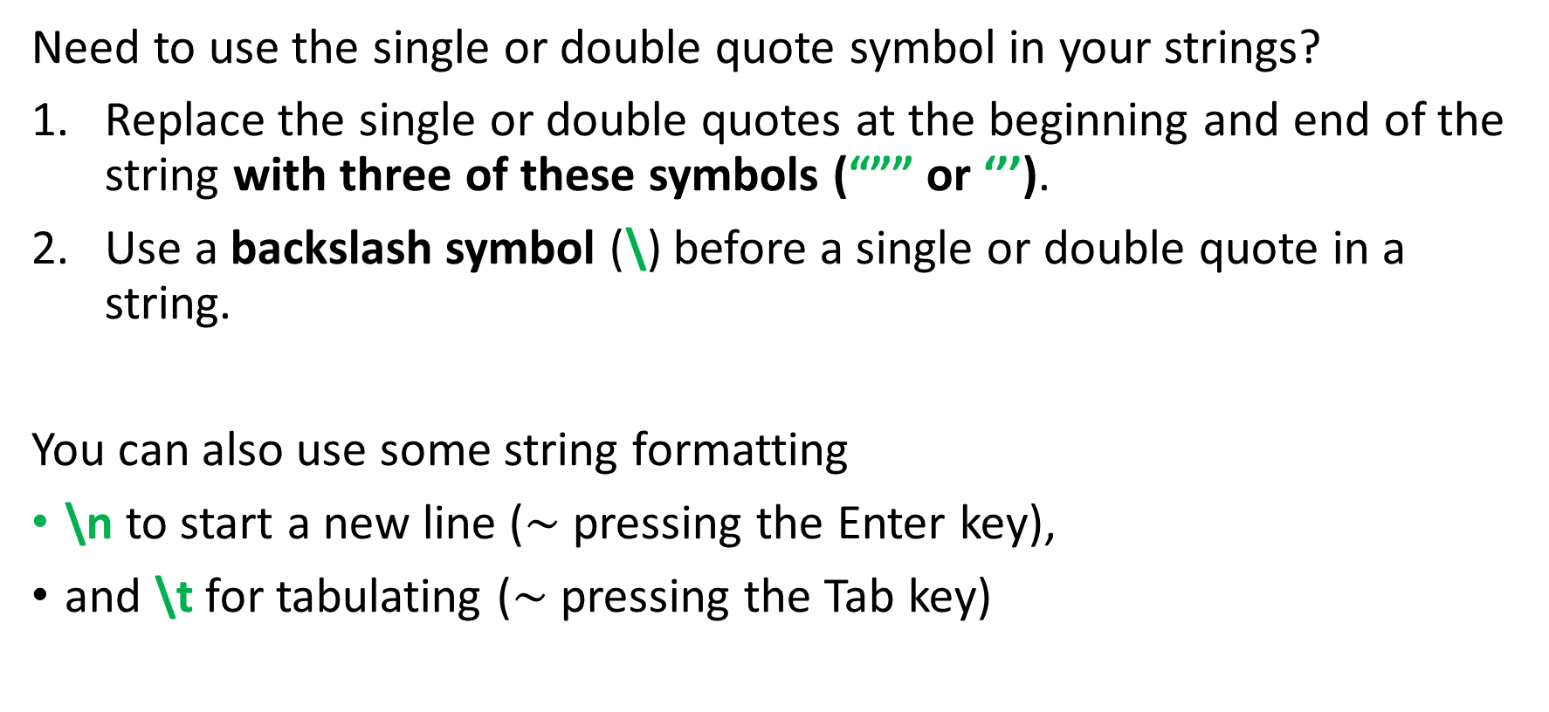
Using triple quotes and string formatting (\)
Need to use the single or double quote symbol in your strings?
Replace the single or double quotes at the beginning and end of the string with three of these symbols (“”” or ‘’’).
Use a backslash symbol (\) before a single or double quote in a string.
You can also use some string formatting
\n to start a new line ($\sim$ pressing the Enter key),
and \t for tabulating ($\sim$ pressing the Tab key)

Slide 9
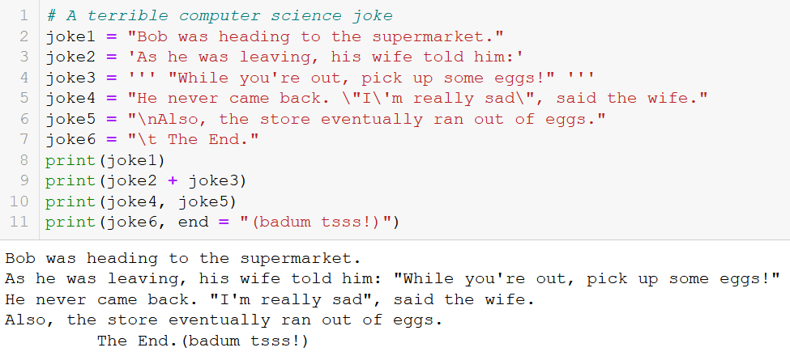
Using triple quotes and string formatting (\)

Slide 10
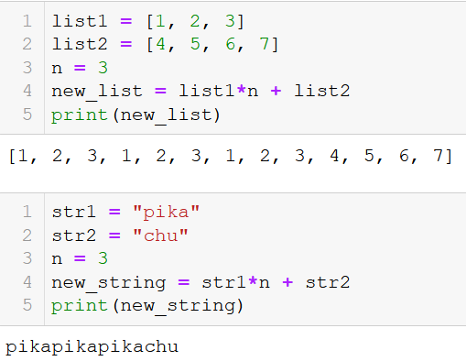
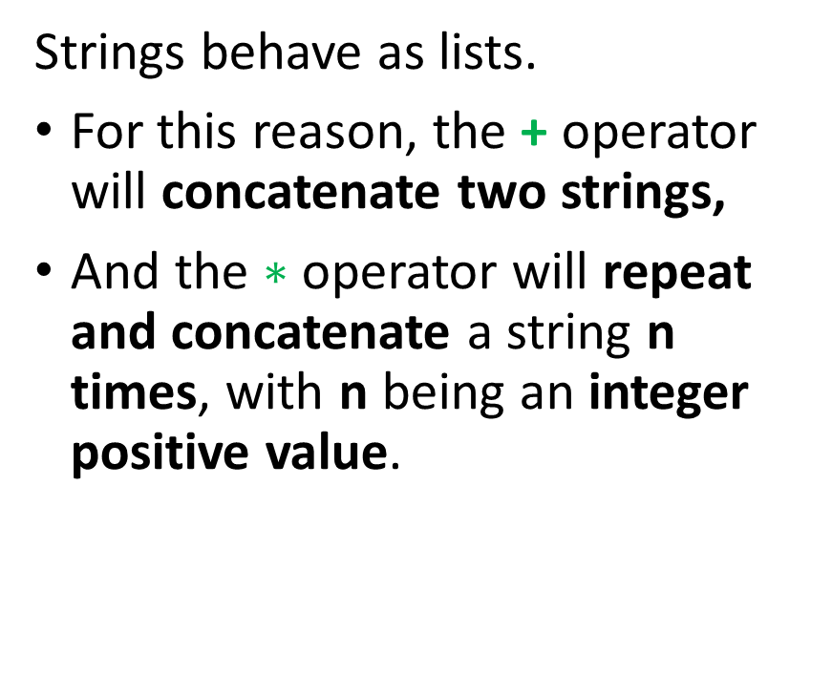

The + and $∗$ operators on strings
Strings behave as lists.
For this reason, the + operator will concatenate two strings,
And the $∗$ operator will repeat and concatenate a string n times, with n being an integer positive value.

Slide 11
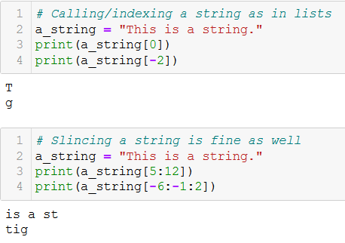
Indexing and slicing a string
As with lists, you can
index a string, by using the bracket notation [] on a list. It returns the character at the index position.
slice a string, by using the bracket notation [] on a list. It returns the substring with specified indexes.

Slide 12
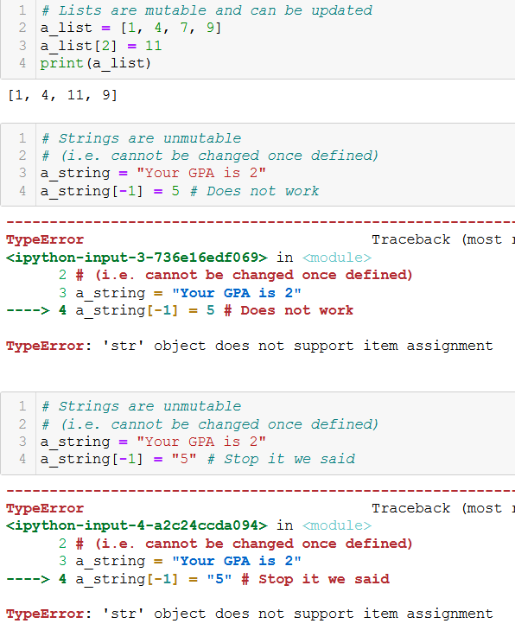
Unmutable types
A major difference between lists and strings, however, is that strings are unmutable.
Unmutable means that you can not modify parts of it, by using the bracket notation, as you would with lists.

Slide 13
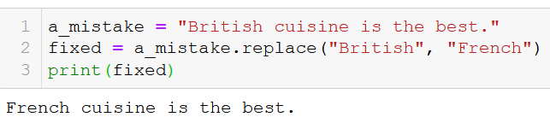
Replacing parts of a string
Instead, the strings come with a replace() method.
Its two parameter are strings s1 and s2 and the method is applied on a third string s3.
The output is a new string, consisting of the third string s3, where the substring s1 has been replaced with s2.
The replace() method replaces all occurrences of s1 in s3 with s2.

Slide 14
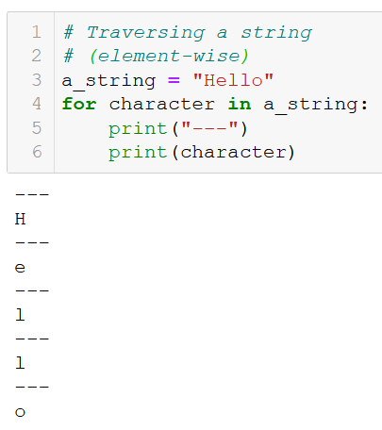
Traversing a string
Because strings are roughly the same things as lists, they can be traversed using a for loop,
Element-wise,

Slide 15
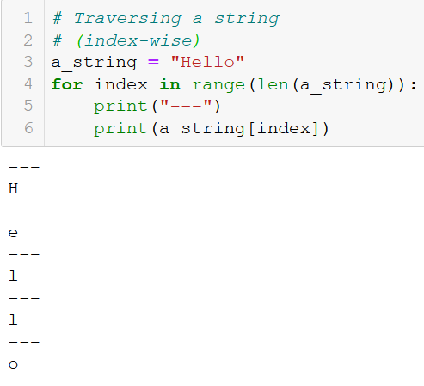
Traversing a string
Because strings are roughly the same things as lists, they can be traversed using a for loop,
Element-wise,
Index-wise,

Slide 16

Traversing a string
Because strings are roughly the same things as lists, they can be traversed using a for loop,
Element-wise,
Index-wise,
Index- and element-wise with enumerate.

Slide 17
Traversing a string
Because strings are roughly the same things as lists, they can be traversed using a for loop,
Element-wise,
Index-wise,
Index- and element-wise with enumerate.
(Zip, etc. also works!)

Slide 18
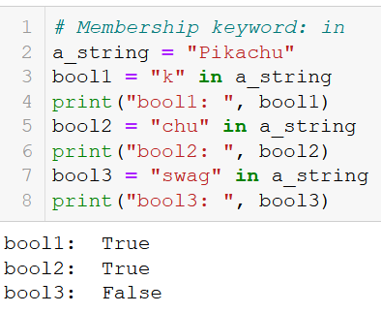
The in keyword
As with lists, the in keyword can be used to check if a character or a string appears in another string.
It returns a Boolean set to True or False accordingly.

Slide 19
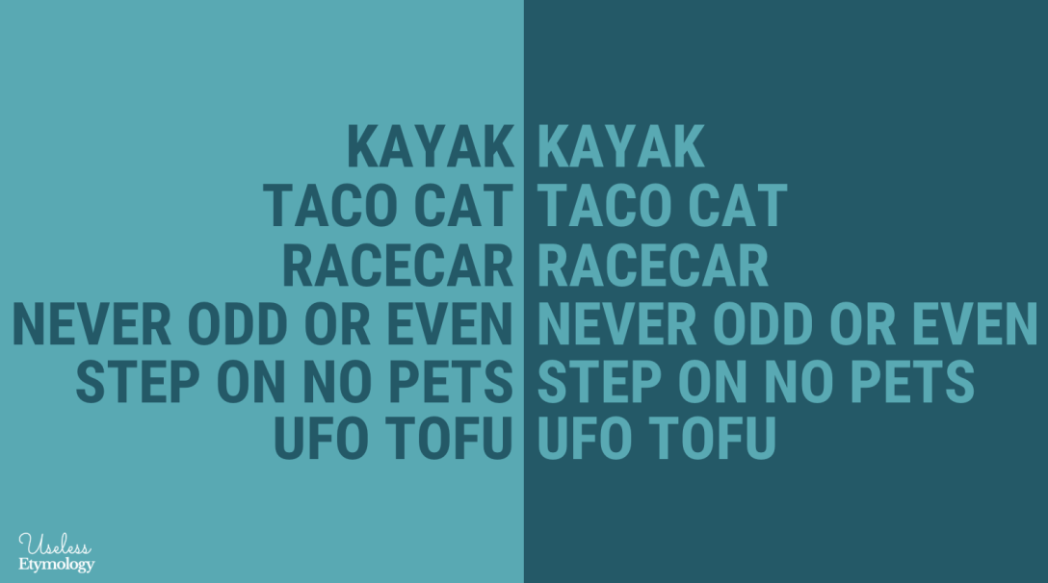
Activity 1 – Is it a palindrome
A palindrome is a word, number, phrase, or other sequence of characters which reads the same backward as forward, such as madam, racecar, etc.
There are also numeric palindromes, including date/time stamps using short digits 11/11/11 11:11 and long digits 02/02/2020.
Sentence-length palindromes may be written when allowances are made for adjustments to capital letters, punctuation, and word dividers, such as "A man, a plan, a canal, Panama!".

Slide 20
Activity 1 – Is it a palindrome
A palindrome is a word, number, phrase, or other sequence of characters which reads the same backward as forward, such as madam, racecar, etc.
There are also numeric palindromes, including date/time stamps using short digits 11/11/11 11:11 and long digits 02/02/2020.
Sentence-length palindromes may be written when allowances are made for adjustments to capital letters, punctuation, and word dividers, such as "A man, a plan, a canal, Panama!".
Write a function is_palindrome(), which receives a single word, in a string variable word as its sole input parameter.
It should return True if the string in question is a palindrome.
And False otherwise.

Slide 21
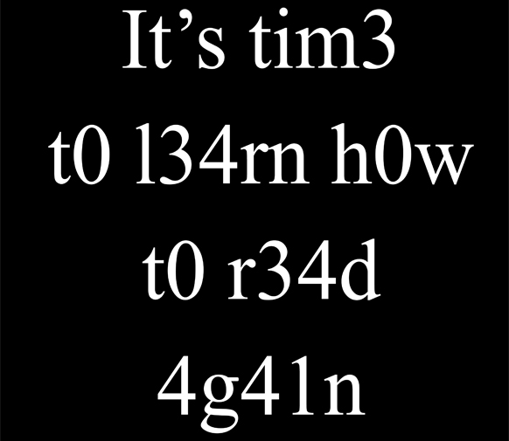
Activity 2 – 1337 speak translators
Leet (or "1337") is a system of modified spellings used primarily on the Internet. It often uses character replacements in ways that play on the similarity of their glyphs via reflection or other resemblance.
Leet speak replaces the letters I with 1, the letters Z with 2, the letters E with 3, the letters A with 4, the letters S with 5, the letters T with 7, the letters B with 8, the letters O with 0.
For instance, the English sentence "HELLO THERE, HOW ARE YOU?" will write in leet speak as "H3LL0 7H3R3, H0W 4R3 Y0U?".

Slide 22
Activity 2 – 1337 speak translators
Leet (or "1337") is a system of modified spellings used primarily on the Internet. It often uses character replacements in ways that play on the similarity of their glyphs via reflection or other resemblance.
Leet speak replaces the letters I with 1, the letters Z with 2, the letters E with 3, the letters A with 4, the letters S with 5, the letters T with 7, the letters B with 8, the letters O with 0.
For instance, the English sentence "HELLO THERE, HOW ARE YOU?" will write in leet speak as "H3LL0 7H3R3, H0W 4R3 Y0U?".
Write a function eng_to_leet().
It receives a single parameter, eng_str, which corresponds to a sentence in English, written in capital letters.
It returns the equivalent sentence in leet speak.
Do so by modifying the letters with numbers, by following the rules we defined earlier.

Slide 23
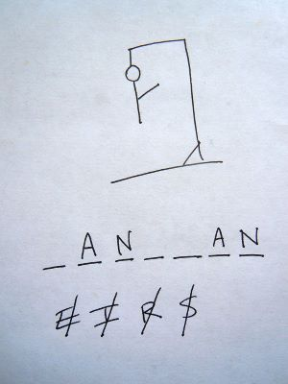
Activity 3 – Hangman
The hangman is a game where one player thinks of a word, phrase or sentence and the other(s) tries to guess it by suggesting letters within a certain number of guesses.

Slide 24
Activity 3 – Hangman
Write a function hangman(), which receives four arguments:
hidden_word: a hidden word that the player must guess. Normally, this word would be hidden from the player, but we will show it for now, as a way to check our function hangman() works as intended.
proposed_letter: a single letter string, corresponding to a letter, which the player just proposed.
letters_list: a list of letters, containing the previous propositions made by the user.
This function returns three arguments:
revealed_word: The revealed word consists of the hidden_word, where the letters in the parameters proposed_letter and letters_list are shown. the other letters are replaced with star (*) characters.
For instance, if the parameters are
hidden_word = "bulbazaur",
proposed_letter = "u",
and letters_list = ["e", "a", "r"] are passed to the function hangman(),
Then it will return revealed_word = "*u**a*aur". Note that all occurrences of the proposed letters should be displayed.

Slide 25
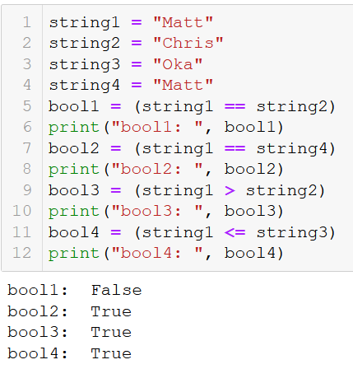
Boolean comparisons on strings
As you have seen earlier, we can use == (resp. !=) to check if two strings are identical (resp. different).
The comparison operators (>, <, >=, <=) can also be used.
These comparison operators compare the alphabetical order between strings.

Slide 26
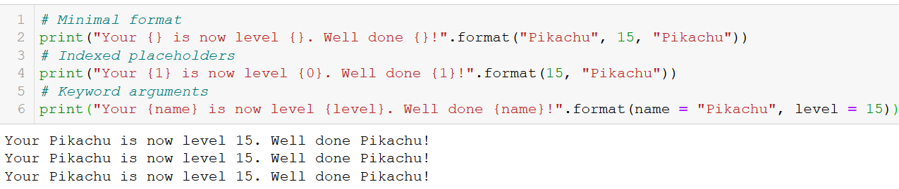
Strings formatting with format()
We have seen how the format() method could be used to insert the values of some variables inside a string. It can operate with indexes or even keywords.
Some arguments can also be passed to the placeholders {}, but this is out of the scope of this class.
https://docs.python.org/3/library/string.html#formatstrings

Slide 27
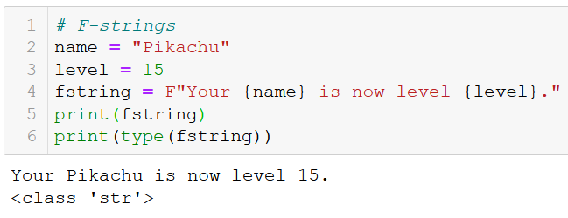
F-strings
The latest versions of Python (3.7+) came with F-strings: the F-strings are strings, but they are preceded by the letter F, to indicate that it contains some placeholders {}.
In F-strings, you can directly pass some variable names inside the placeholders, which is simpler than using format().

Slide 28
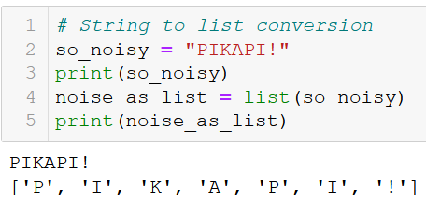
Lists <-> Strings conversions
Because lists and strings are roughly the same thing, it is sometimes convenient to convert one into the other.
Str -> List: easily done with list(), which gives a list of characters.

Slide 29
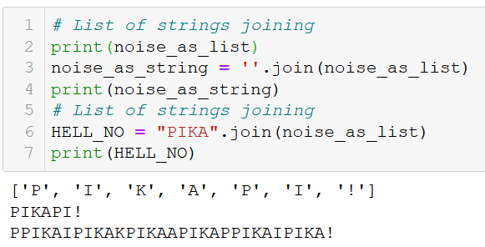
Lists <-> Strings conversions
List -> Str: done with the join() method, often applied on an empty string “”.
Applying it on something else than an empty string leads to… interesting results.

Slide 30
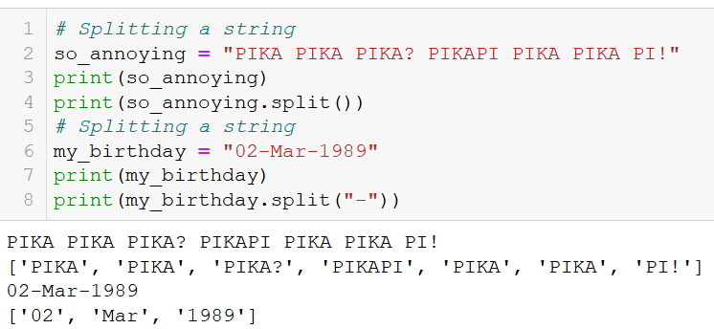
Splitting a string into a list of strings
If needed you can split a large string into a list of smaller ones, with the split() method.
By default, it returns a list of the different words in the string.
You can also specify a substring to use as a separator.
Typically convenient for dates (14/10/2020), hours (14:52:26), etc.

Slide 31
Activity 4 - Create password from sentence
A passphrase is a sentence which can be used to create passwords that are difficult to crack and easy to memorize.
The user simply needs to create a memorable sentence containing multiple words.
Later on, the user will assemble a password by alternating the first letter of each word in the passphrase and the number of characters in it. In addition, add the special characters when they appear.

Slide 32
Activity 4 - Create password from sentence
A passphrase is a sentence which can be used to create passwords that are difficult to crack and easy to memorize.
The user simply needs to create a memorable sentence containing multiple words.
Later on, the user will assemble a password by alternating the first letter of each word in the passphrase and the number of characters in it. In addition, add the special characters when they appear.
For instance, the sentence
"I used to be an adventurer like you until I took an arrow to the knee“
can be used to generate the following password
"I1u4t2b2a2a10l4y3u5I1t4a2a5t2t3k4“

Slide 33
Activity 4 - Create password from sentence
A passphrase is a sentence which can be used to create passwords that are difficult to crack and easy to memorize.
The user simply needs to create a memorable sentence containing multiple words.
Later on, the user will assemble a password by alternating the first letter of each word in the passphrase and the number of characters in it. In addition, add the special characters when they appear.
For instance, the sentence
"I used to be an adventurer like you until I took an arrow to the knee“
can be used to generate the following password
"I1u4t2b2a2a10l4y3u5I1t4a2a5t2t3k4“
Write a function generate_password(), which receives a passphrase as its only parameter, and returns a single output, consisting of a string generated according to the method we described.

Slide 34
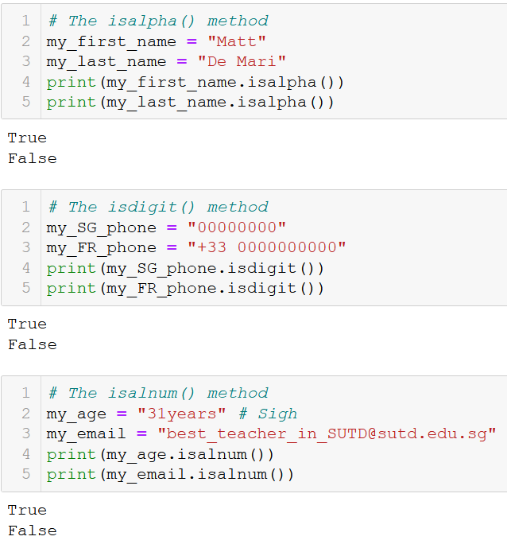
Characters types check in strings
You can check for characters types in a string with 3 methods.
isalpha() returns True is characters are letters only; and False otherwise.
isdigit() returns True if the characters are digits only; and False otherwise.
isalnum() returns True if the characters are letters and digits only; and False otherwise.

Slide 35
Activity 5 – Password checker
Write a function password_check(), which receives a single parameter, password, consisting of a string variable.
This function returns a boolean with value True if:
the password has at least 8 characters,
the password contains both letters and numbers,
and the password contains at least one special character (i.e. a non-number, non-letter character).
Otherwise, the function returns False.

Slide 36
As usual, RTFM!
Strings are one of the most furnished types in Python, with many more methods.
Read more about strings, here!
https://docs.python.org/2/library/string.html

Slide 37
Conclusion
The string type (and similarities with the list type)
Indexing, slicing, and traversing a string
Updating a string and unmutability
Membership and find
Booleans on strings, sorting
Printing and formatting
Strings <-> lists conversions
Splitting, character checking
(More stuff, RTFM!)

Slide 38
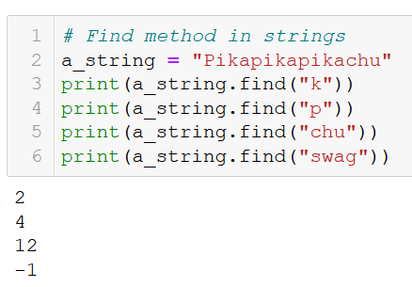
The find() method
The strings come with an additional method, called find(), which looks for a character or substring inside another string.
It returns the index of the first appears of said character or substring inside the string.
If the character or substring does not appear, it returns -1.

Slide 39
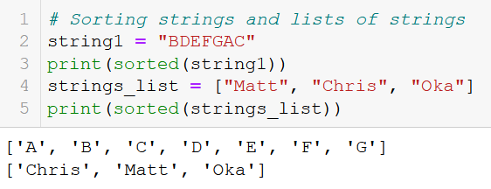
Sorting strings and lists of strings
We have seen earlier how the sorted() function could be used to sort a list of strings alphabetically.
It can also be applied on a single string. This produces a list of characters, in alphabetical order.

Slide 40
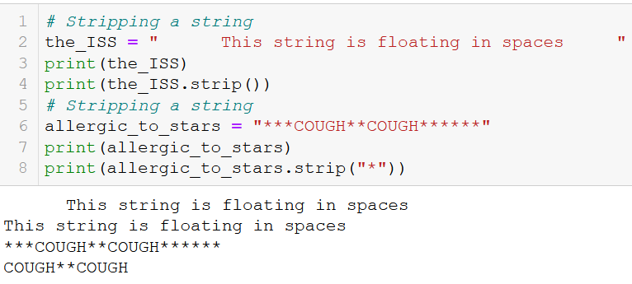
Additional: functions, strip-cleaning a string
Strip-cleaning a string removes the extra spaces, if any, at the beginning and end of a string.
If a substring is passed to the split() method, it will remove the occurrences of these extra characters at the beginning and end of the string.

Slide 41
As usual, RTFM!
Strings are one of the most furnished types in Python, with many more methods.
Read more about strings, here!
https://docs.python.org/2/library/string.html

